Slide 1
CSE – 326 CA – 3
INCOME TAX DEPARTMENT WEBSITE
PROJECT REPORT
Made By – Akshay Prasad
Anirban Sasmal
Mohammed Shinad
Section – K22CK
Submitted To
Ms.SANDEEP KAUR

Slide 2
OBJECTIVES
To replicate the Indian income tax website at a beginner level using basic knowledge in HTML, CSS and Javascript.
TECHNOLOGY USED
We have developed this project using the below technology.
HTML - Page layout has been designed in HTML.
CSS - CSS has been used for all the designing part
Javascrpit.

Slide 3
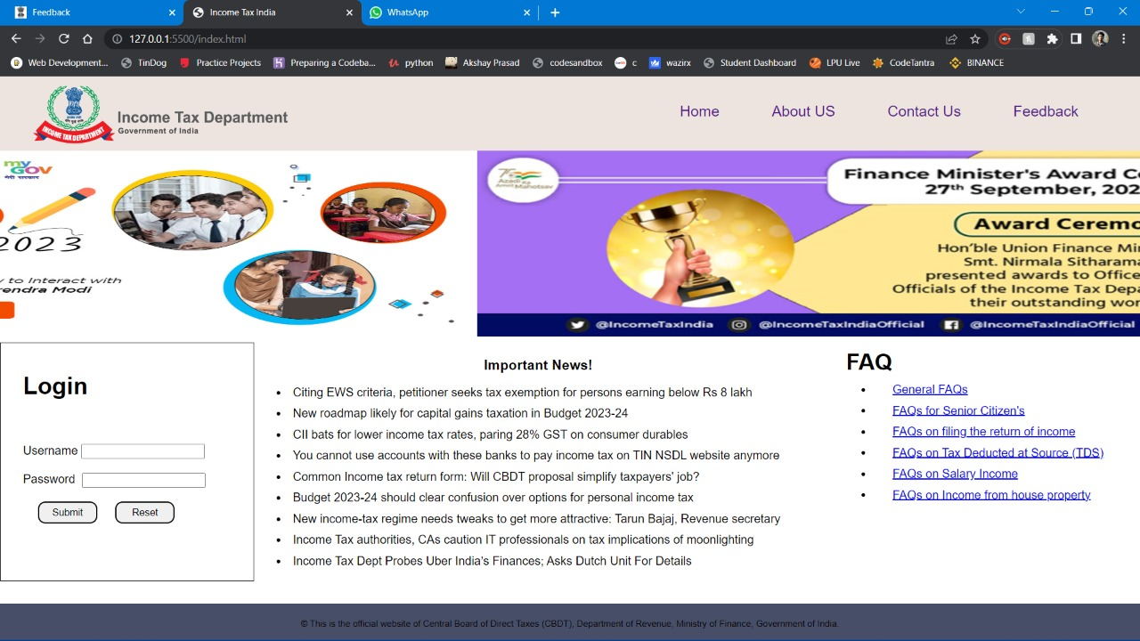
HOME WEBPAGE

Slide 4
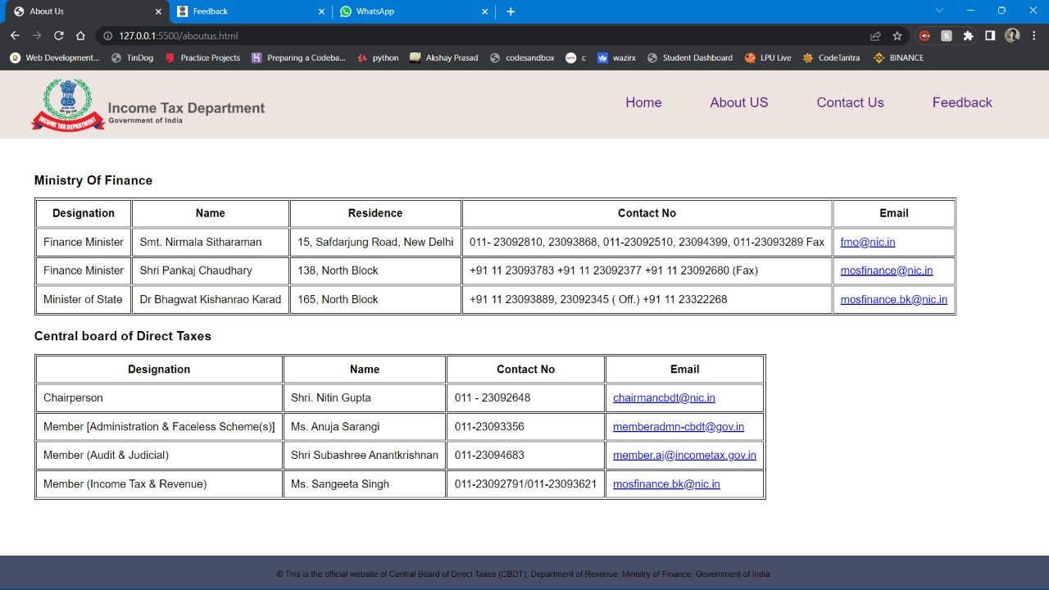
ABOUT-US WEBPAGE

Slide 5
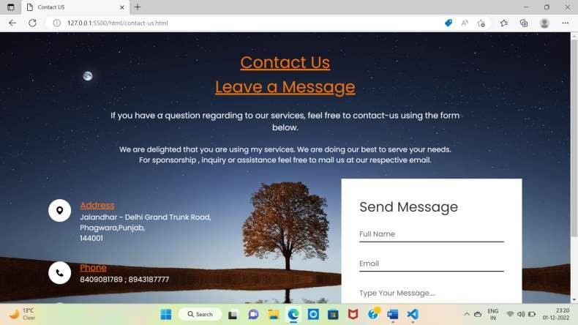
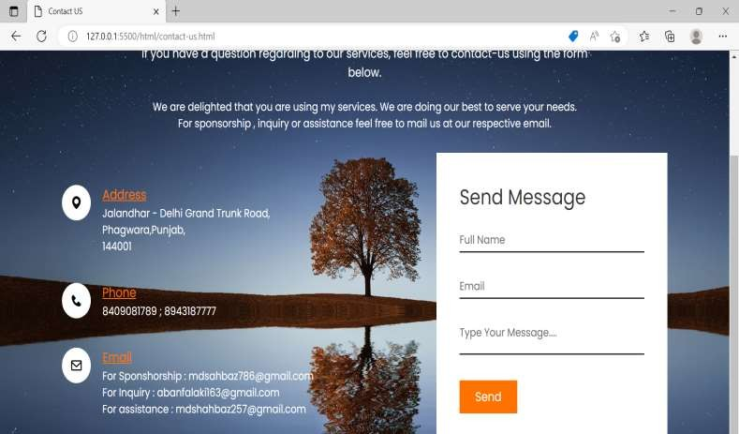
CONTACT WEBPAGE

Slide 6
HOMEPAGE
This page contains information about
Login Details
Important News
FAQ
ABOUT US
This Page contains information about
Ministry of Finance
Central Board of Direct Taxes

Slide 7
BOOKTICKET
This page contains
Movie selection
Seat selection where you want to sit
Submit option for ticket confirmation
Work done by ABBAN FALAKI (12216203)
TICKET PAGE
This page contains
Ticket photo
Ticket details
Download ticket
Work done by MD SHAHBAZ ALAM (12216319)

Slide 8
ABOUT PAGE
This page contains
About cinema hall
About webpage
Who create this
Work done by ABBAN FALAKI (12216203)
CONTACT PAGE
This page contains
Address of creator of webpage
Phone no. of creator of webpage
Email of creator of webpage
Any message you want to send then you send via send option after writing message, name and email.

Slide 9
REFERENCE
GITHUB
GEEKS FOR GEEKS
W3 SCHOOL
YOUTUBE

Slide 10





